Slide 1

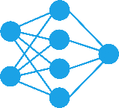
Perceptron
Hamidreza Baradaran Kashani
Neural Networks Course (Fall 2022)
1

Slide 2
Objectives
Getting familiar with Perceptron and its architecture
Solving a simple pattern recognition problem using perceptron
Training a single-layer perceptron by perceptron learning rule
Investigating the limitations of single-layer perceptrons
2

Slide 3
List of Contents
Perceptron
A Pattern Recognition Problem
Perceptron Architecture
Perceptron Learning Rule
Convergence and Limitations
3

Slide 4
History
In 1943, Warren McCulloch and Walter Pitts introduced one of the first artificial neurons. The parameters of their networks had to be designed (There was no learning rule).
In 1958, Frank Rosenblatt introduced perceptron. His key contribution was the introduction of a learning rule for training perceptron networks to solve pattern recognition problems.
In 1969, Marvin Minsky and Seymour Papert demonstrated that the perceptron networks were incapable of implementing certain elementary functions.
4

Slide 5
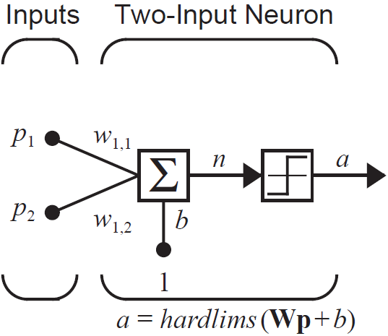
Perceptron
Perceptron is a feed-forward neural network with binary output
if the input is greater than (or equal to) a threshold, the output would be 1, otherwise it would be 0 (or -1).
a 2-input single-neuron perceptron with hardlims transfer function is shown here:
W = [ w$_{1 , 1}$ w$_{1 , 2}$ ]
5

Slide 6
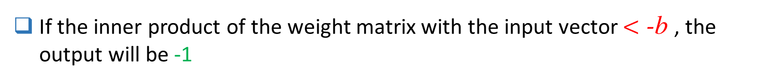
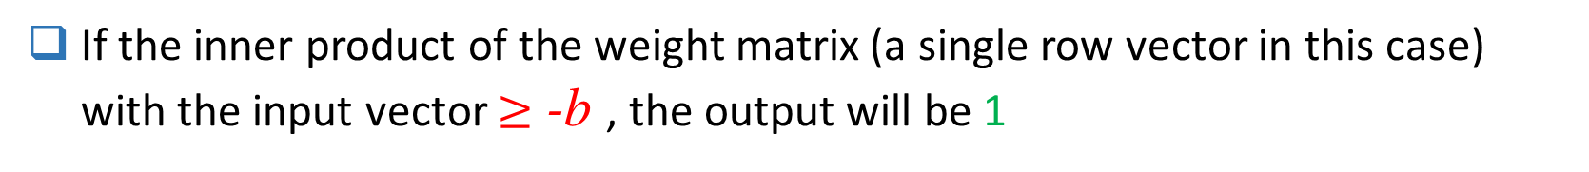
Perceptron
for example if w$_{1 , 1}$ = -1 and w$_{1 , 2}$ = 1 then:
If the inner product of the weight matrix (a single row vector in this case) with the input vector $≥$ -b , the output will be 1
If the inner product of the weight matrix with the input vector $<$ -b , the output will be -1
The input space is divided into two parts.
6
Notes:
تابع انتقال hardlim به پرسپترون این امکان را می دهد که فضای بردارهای ورودی را به دو ناحیه تقسیم کند.

Slide 7

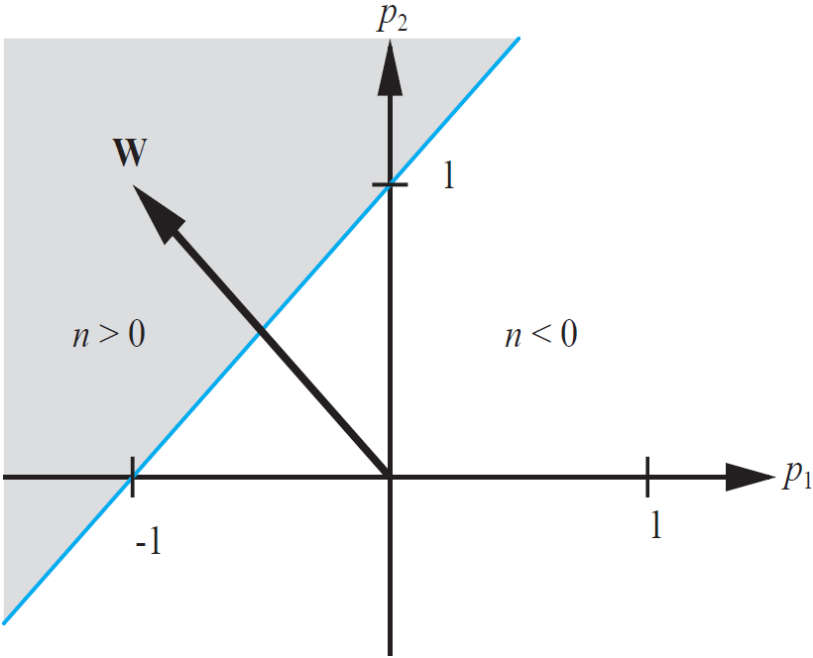

Perceptron
The decision boundary is obtained by:
The net input (n) is 0 for all points on the decision boundary (the blue line).
Suppose that b = -1 then:
The decision boundary will always be orthogonal to the weight matrix and the position of the boundary can be shifted by changing the bias.
7
Notes:
شیب مرز تصمیم به ماتریس وزن بستگی دارد. و بر اساس مقدار بایاس مرز تصمیم به سمت راست یا چپ شیفت پیدا میکند.
به عبارتی با تغییر وزن و بایاس می توانیم فضا را به هر دو ناحیه دلخواه تقسیم بندی کنیم.
اگر بایاس نداشته باسیم مرز تصمیم از مبدا می گذرد
اگر نمونه [-0.5 0.5] که بر روی مرز تصمیم قرار دارد را در معادله خط یا همان مرز تصمیم بگذاریم مقدار b=-1 حاصل می شود

Slide 8
Perceptron
The shaded region contains all input vectors for which the output of the network will be 1. The output will be -1 for all other input vectors.
The single-layer perceptron can only be used to recognize patterns that are linearly separable (can be separated by a linear boundary).
If we have more than one neuron, W will have more than one row, each of which will form a decision boundary.
8
Notes:
یک شبکه پرسپترون با یک نرون توانایی ظبقه بندی بردارهای ورودی را در دو دسته دارد.
هر نرون یک مرز تصمیم ایحاد می کند
یک شبکه پرسپترون تک لایه منظور آن است که فقط یک لایه خروجی دارد و آن تابع فعالساز نیز که هاردلیمیت است وقتی به عنوان تابع فعالساز خروجی است و چون لایه مخفی ندارد پس عملا فقط الگوهایی که بصورت خطی جداپذیر هستند را می توان با یک پرسپترون تک لایه جدا کرد.

Slide 9
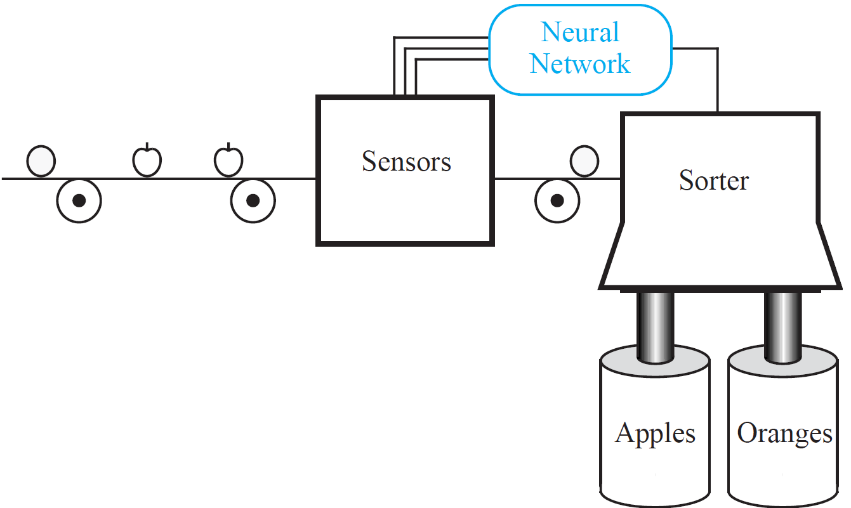
A Pattern recognition problem
Apples and oranges are mixed up. The purpose is to recognize them according to their type by a neural network (classification problem)
9

Slide 10
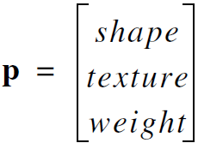
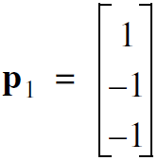
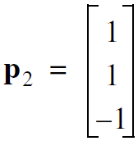
A Pattern recognition problem
There are 3 sensors which determine inputs of the network.
Shape: 1 = round -1 = elliptical
Texture: 1 = smooth -1 = rough
Weight: 1 = more than one pound -1 = less than one pound
Two prototypes (patterns) are given to the network as input vectors:
orange:
apple:
10

Slide 11
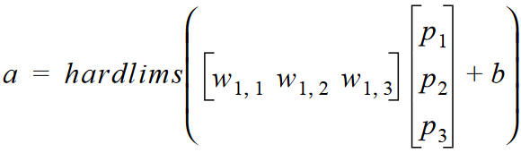
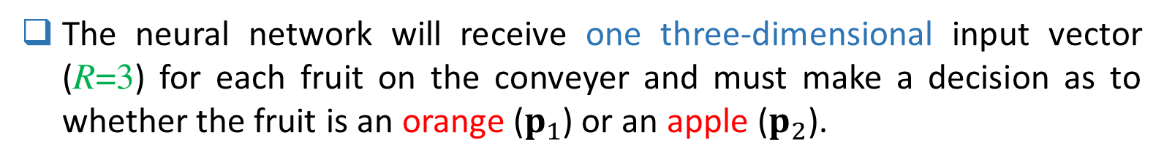
A Pattern recognition problem
The neural network will receive one three-dimensional input vector (R=3) for each fruit on the conveyer and must make a decision as to whether the fruit is an orange ($p_{1}$) or an apple ($p_{2}$).
We use a single-neuron perceptron because there are only 2 categories. The perceptron equation will be:
We want the output of the perceptron to be 1 when an apple is input and -1 when an orange is input.
11

Slide 12
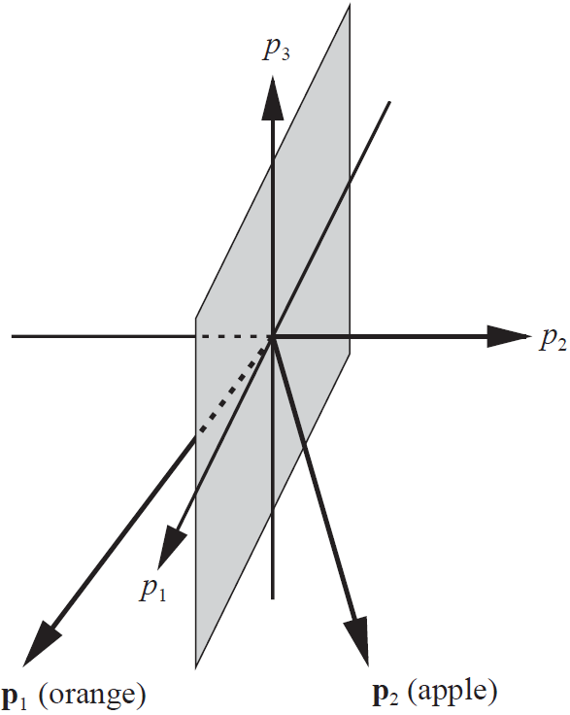
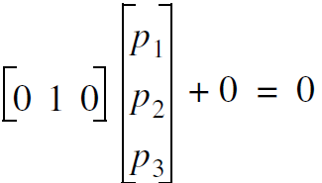

A Pattern recognition problem
Actually the parameters of our model (bias and weight matrix) should be learned from data, but in this case we choose them.
If we choose W = [0 1 0] and b = 0 then the decision boundary will be $p_{1},p_{3}$ plane with equation:
$$⇒$$
12
Notes:
P2=0 معادله صفحه جداکننده است.

Slide 13
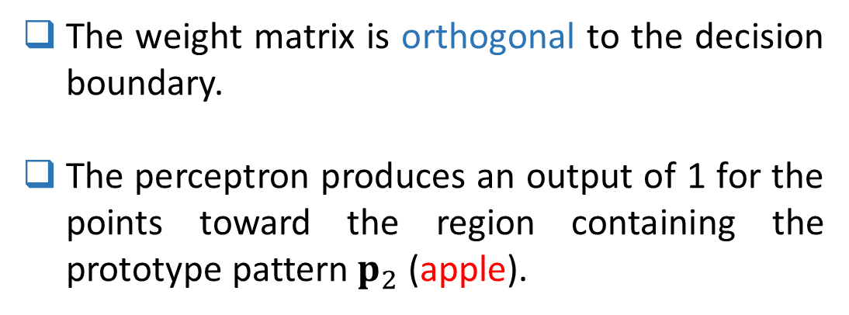
A Pattern recognition problem
The weight matrix is orthogonal to the decision boundary.
The perceptron produces an output of 1 for the points toward the region containing the prototype pattern $p_{2}$ (apple).
The boundary passes through the origin because b = 0
13

Slide 14
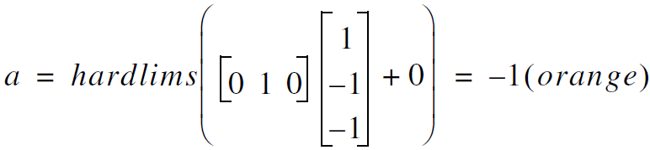
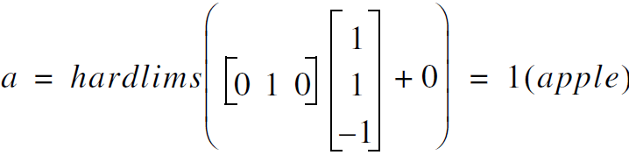
A Pattern recognition problem
Test our model:
for orange:
for apple:
14

Slide 15
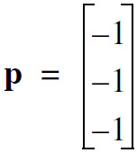
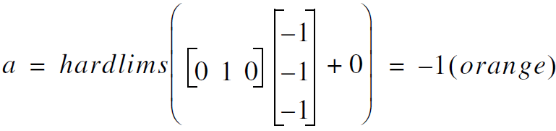
A Pattern recognition problem
What happens if we put a not-so-perfect orange into the classifier? For instance an orange with an elliptical shape is passed through the sensors
The input vector:
The response of the network:
So any input vector that is closer to the orange prototype vector than to the apple prototype vector (in Euclidean distance) will be classified as an orange (and vice versa).
15
Notes:
به نظر خودم الان وزن های شبکه به گونه ای است که به ویژگی های اول یعنی شکل میوه و ویژگی سوم یعنی وزن میوه اهمیتی نمی دهد چرا که مولفه های اول و سوم بردار وزن صفر است. در مقابل مولفه دوم وزن یک است پس دارد به ویژگی دوم که بافت یا پوست میوه است اهمیت می دهد. در عمل نی قرار است شبکه خودش یادبگیرد که کدام ویژگی یا ویژگی ها مهمتر هستند در جداپذیری کلاس ها از یکدیگر.

Slide 16
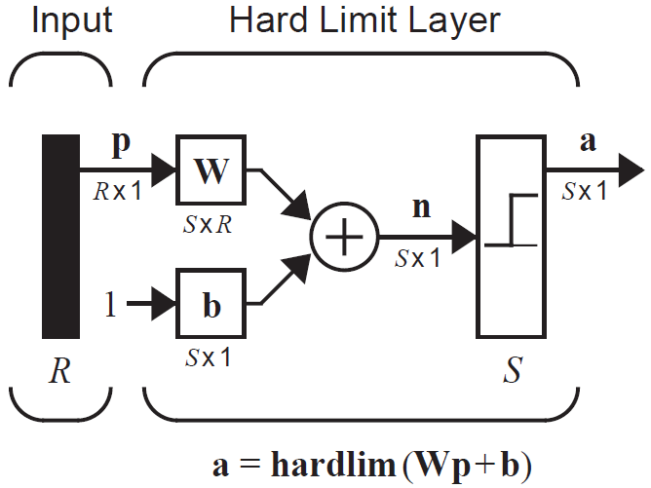
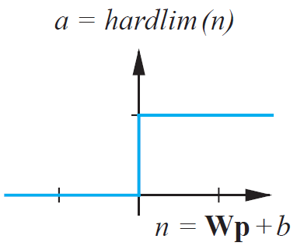
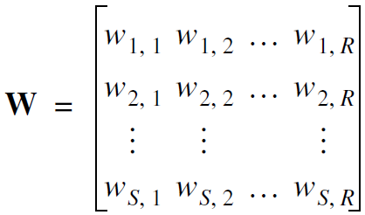
Perceptron Architecture
Note that we use unit step (hardlim) function instead of hardlims in this section which produces 0 or 1 (instead of -1 or 1)
16

Slide 17
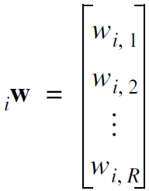
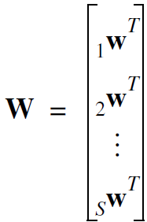
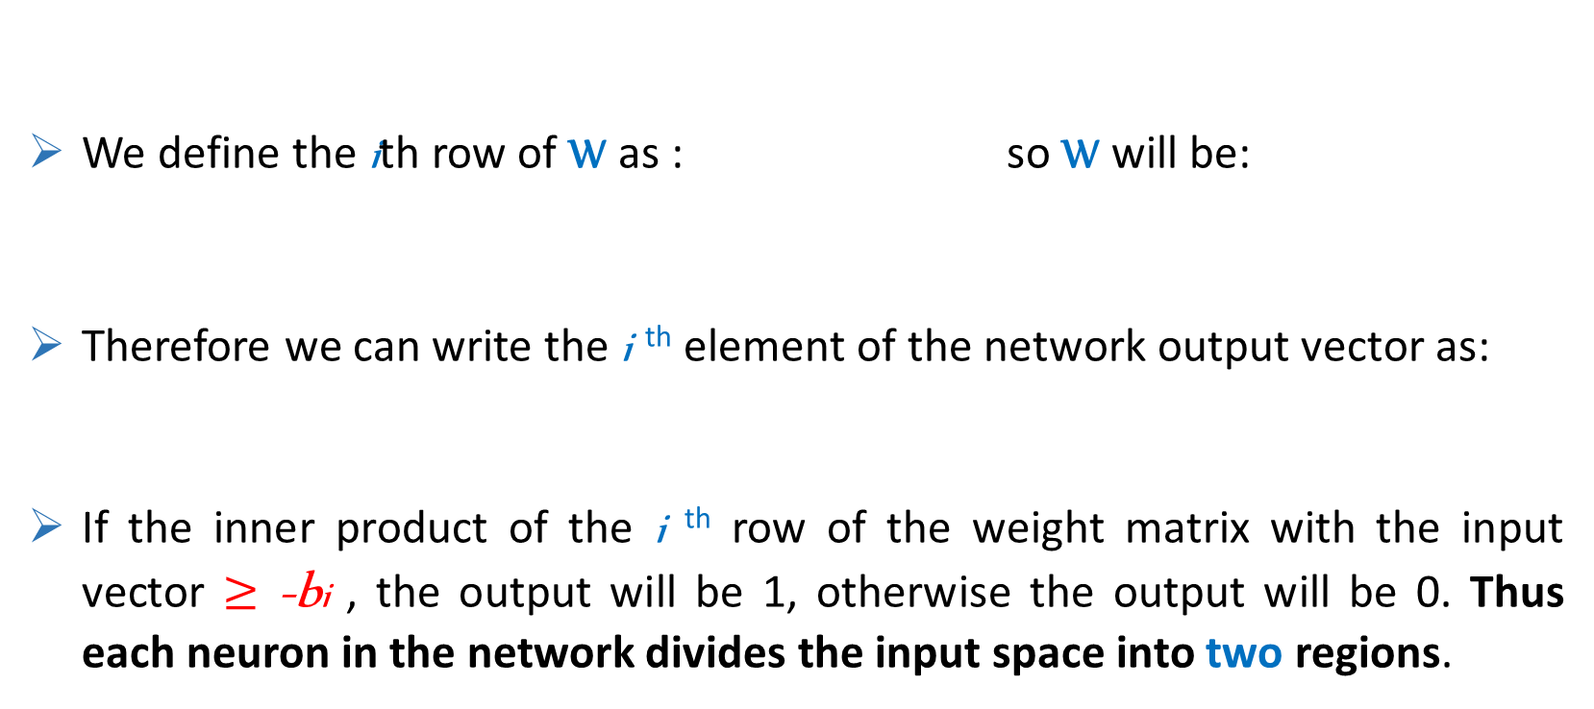
Perceptron Architecture
We define the ith row of W as : so W will be:
Therefore we can write the i ^{th} element of the network output vector as:
If the inner product of the i ^{th} row of the weight matrix with the input vector $≥$ -bi , the output will be 1, otherwise the output will be 0. Thus each neuron in the network divides the input space into two regions.
17

Slide 18
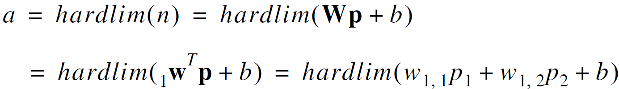
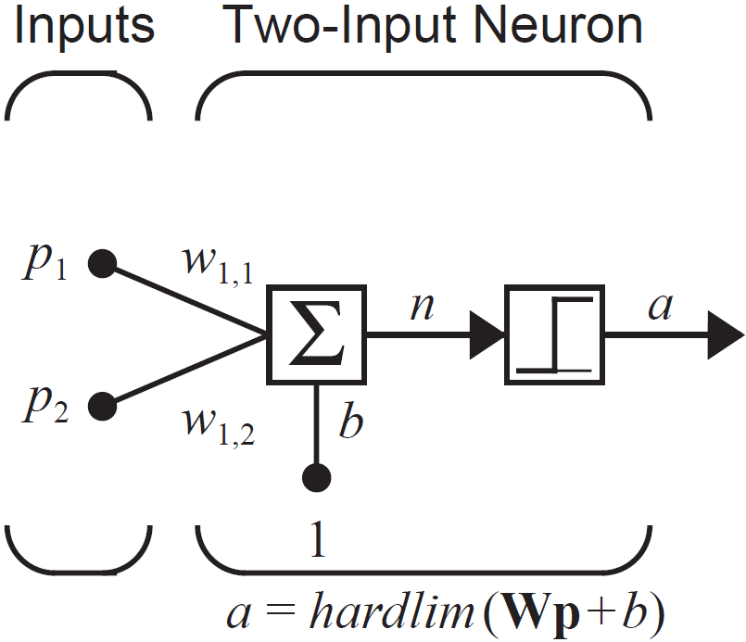
Perceptron Architecture
Single-Neuron Perceptron with two inputs:
The output is determined by:
Then the decision boundary is:
18

Slide 19

Perceptron Architecture
let’s assign the following values for the parameters:
The decision boundary is then:
19

Slide 20
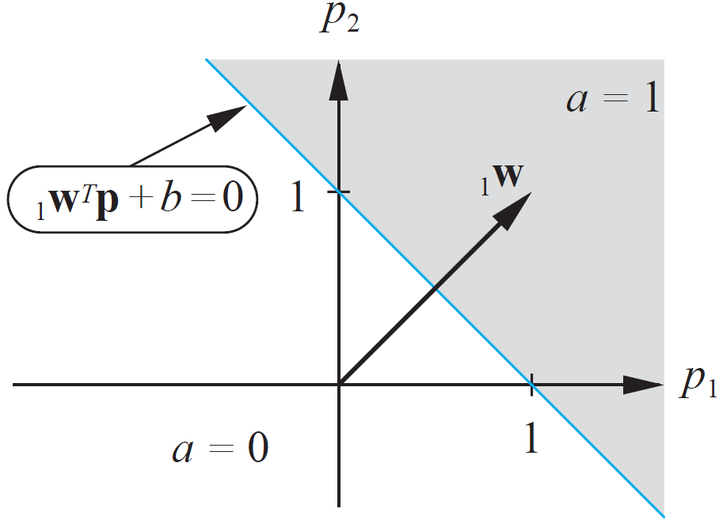
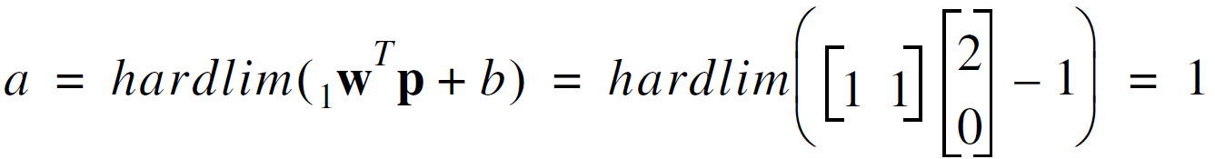

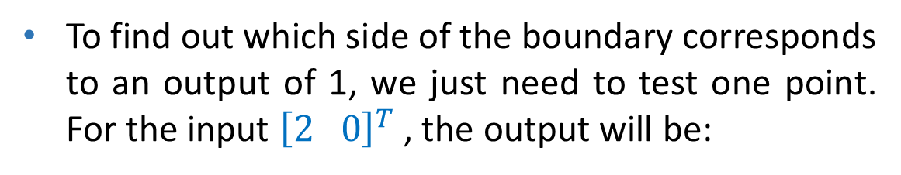
Perceptron Architecture
To find out which side of the boundary corresponds to an output of 1, we just need to test one point. For the input ${\left[2 0\right]}^{T}$ , the output will be:
We can also find the decision boundary graphically. First we should determine the orientation of it by the fact that it is always orthogonal to . Then we set its position in order to satisfy for all points on it.
20

Slide 21
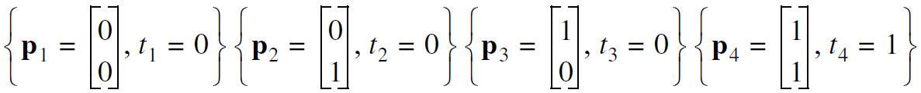
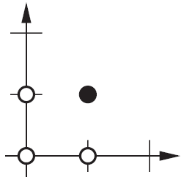
Perceptron Architecture
Example: AND function The input/target pairs are:
Light circles: 0 Dark circle: 1
We want to have a line that separates the dark circles and the light circles. The first step of the design is to select a decision boundary. There are an infinite number of solutions to this problem.
1
21

Slide 22
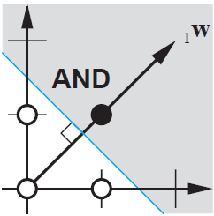
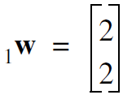
Perceptron Architecture
Example (Cont.): We select the line that falls “halfway” between the two categories of inputs.
2
The weight vector should be orthogonal to the decision boundary. It can be any length, so there are infinite possibilities. One choice is:
22

Slide 23
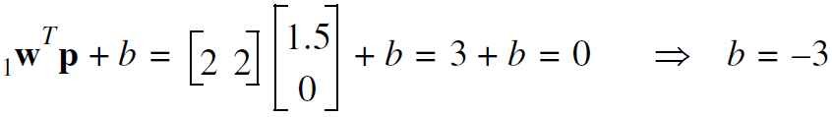
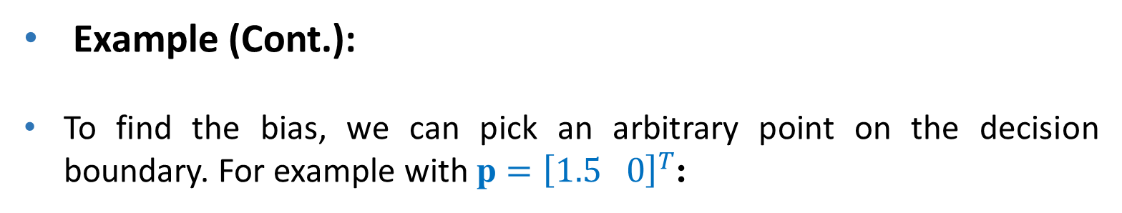
Perceptron Architecture
Example (Cont.):
To find the bias, we can pick an arbitrary point on the decision boundary. For example with p $={\left[1.5 0\right]}^{T}$:
3
23

Slide 24
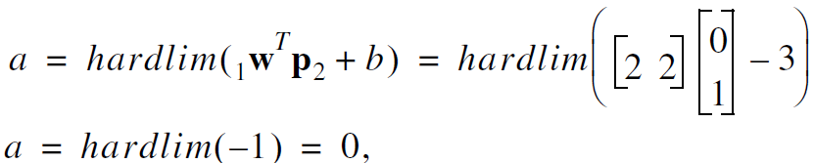

Perceptron Architecture
Example (Cont.): To test the network, we apply ${\text{p}}_{2}$ to the network:
which is equal to the target output $t_{2}$. The rest of inputs are correctly classified too.
4
24

Slide 25

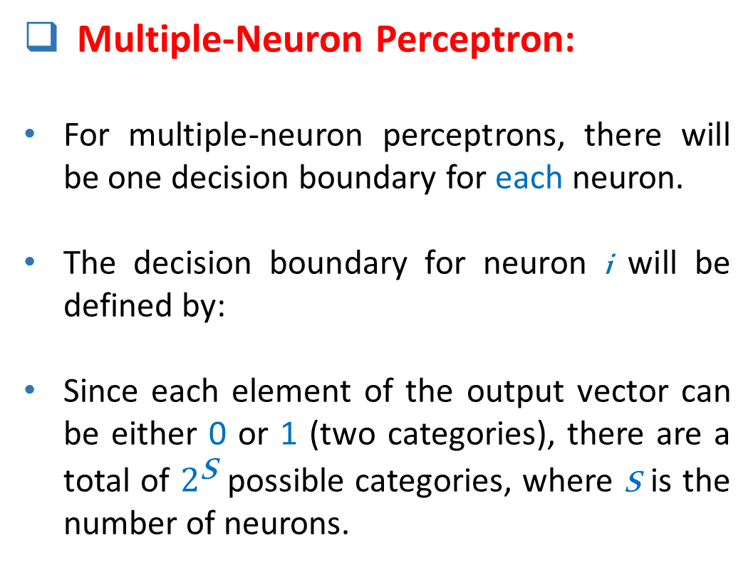
Perceptron Architecture
Multiple-Neuron Perceptron:
For multiple-neuron perceptrons, there will be one decision boundary for each neuron.
The decision boundary for neuron i will be defined by:
Since each element of the output vector can be either 0 or 1 (two categories), there are a total of $2^{\text{S}}$ possible categories, where S is the number of neurons.
25
Notes:
* پس این نکته پایانی می گوید با یک پرسپترون تک نرونی یعنی S=1 فقط می توان دو کلاس را جدا کرد (البته دو کلاسی که بصورت خطی جداپذیر باشند)

Slide 26
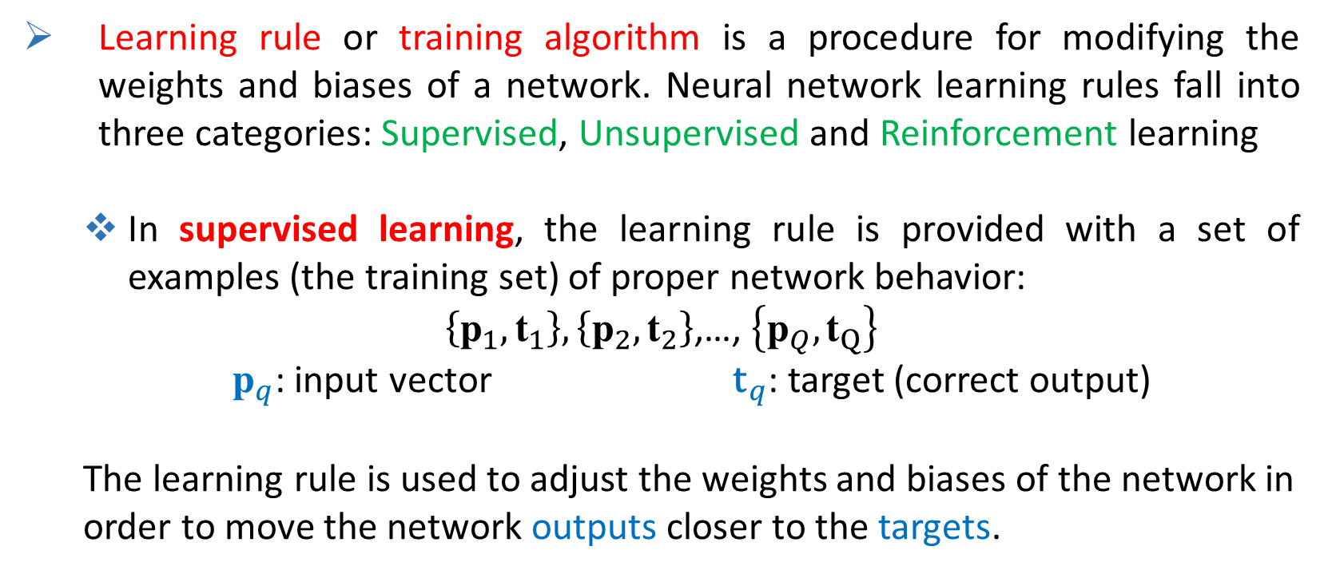
Perceptron Learning Rule
Learning rule or training algorithm is a procedure for modifying the weights and biases of a network. Neural network learning rules fall into three categories: Supervised, Unsupervised and Reinforcement learning
In supervised learning, the learning rule is provided with a set of examples (the training set) of proper network behavior:
$\left\{{\text{p}}_{1},{\text{t}}_{1}\right\},\left\{{\text{p}}_{2},{\text{t}}_{2}\right\}$,…, $\left\{{\text{p}}_{Q},{\text{t}}_{Q}\right\}$
${\text{p}}_{q}$: input vector ${\text{t}}_{q}$: target (correct output)
The learning rule is used to adjust the weights and biases of the network in order to move the network outputs closer to the targets.
26

Slide 27
Perceptron Learning Rule
Reinforcement learning is similar to supervised learning, except that, instead of being provided with the correct output for each network input, the algorithm is only given a reward.
In unsupervised learning There are no target outputs available. Most of these algorithms perform some kind of clustering operation. They learn to categorize the input patterns into a finite number of Categories.
The perceptron learning rule is a training algorithm for perceptron networks to solve supervised problems.
27

Slide 28
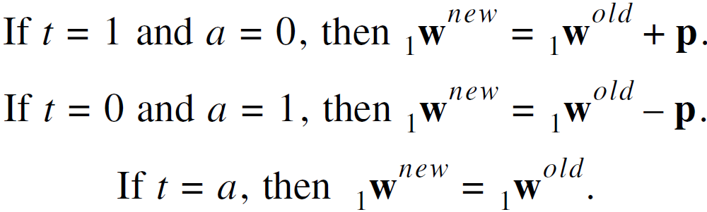
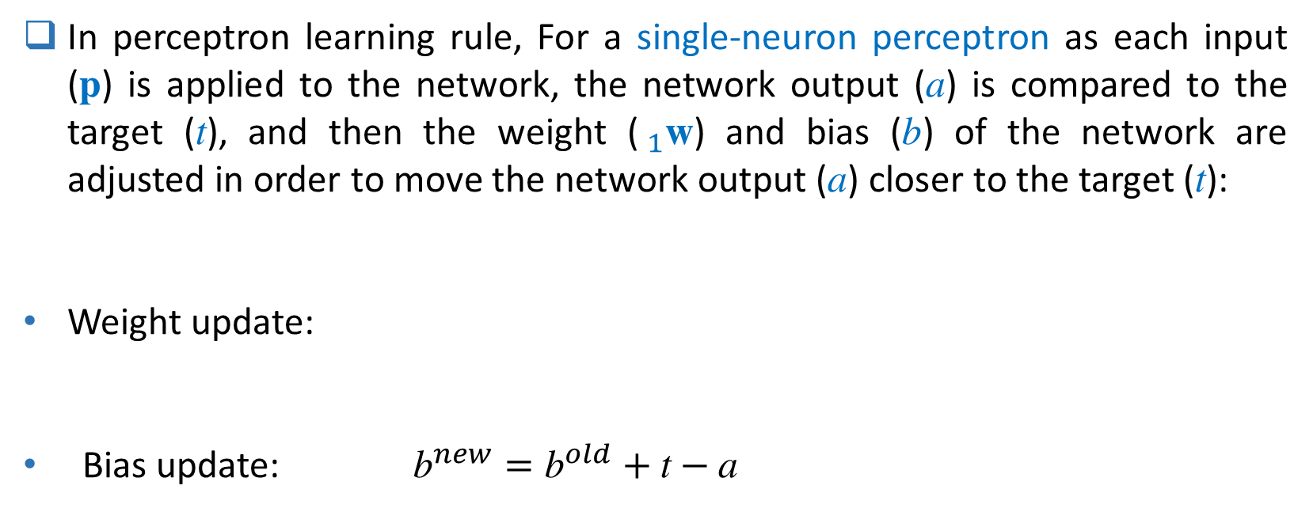
Perceptron Learning Rule
In perceptron learning rule, For a single-neuron perceptron as each input (p) is applied to the network, the network output (a) is compared to the target (t), and then the weight ($_{1}\text{w}$) and bias (b) of the network are adjusted in order to move the network output (a) closer to the target (t):
Weight update:
Bias update: ${\text{b}}^{new}={\text{b}}^{old}+\text{t}−\text{a}$
28

Slide 29
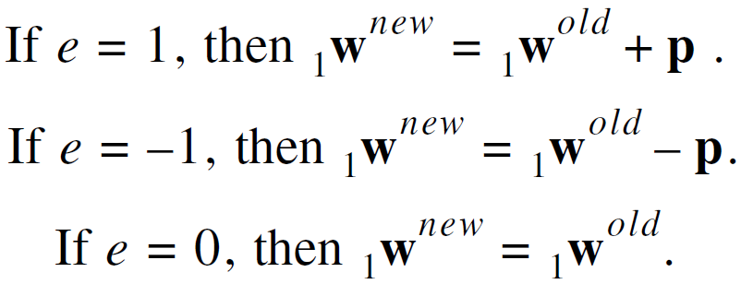

Perceptron Learning Rule
The three rules of weight update can be rewritten as a single expression.
We define the perceptron error: e = t – a and rewrite them as:
Then we unify them as:
The bias update rule is the same will be: ${\text{b}}^{new}={\text{b}}^{old}+\text{e}$
29

Slide 30
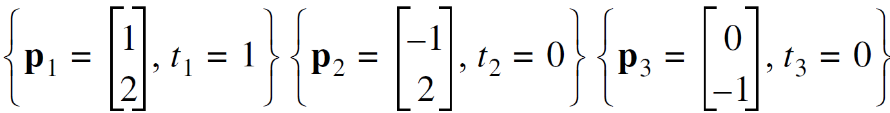
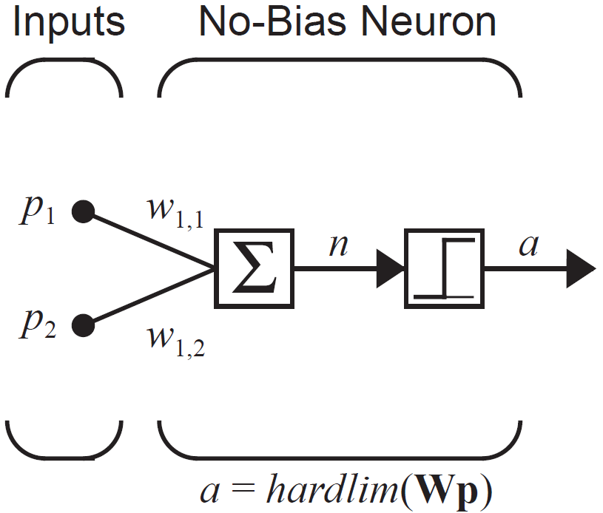
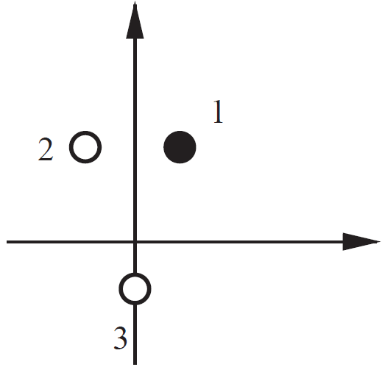
Perceptron Learning Rule
Example 1:
Goal: train a single-neuron perceptron to classify these patterns.
We assume there is no bias in the perceptron (b = 0) for simplicity.
The architecture:
1
30

Slide 31
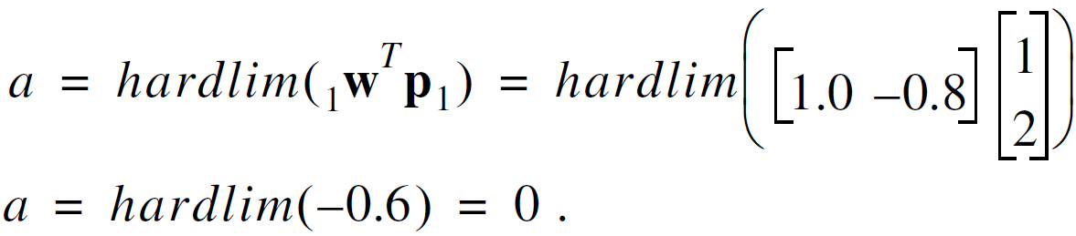
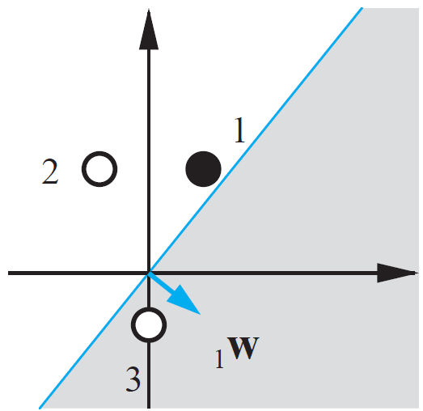
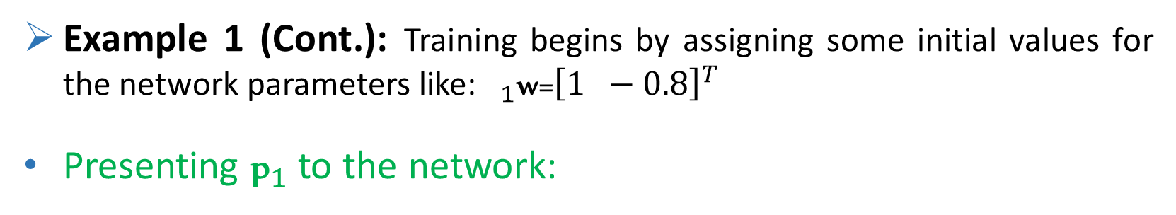
Perceptron Learning Rule
Example 1 (Cont.): Training begins by assigning some initial values for the network parameters like: $_{1}\text{w}\text{=}{\left[1 −0.8\right]}^{T}$
Presenting ${\text{p}}_{1}$ to the network:
2
31

Slide 32
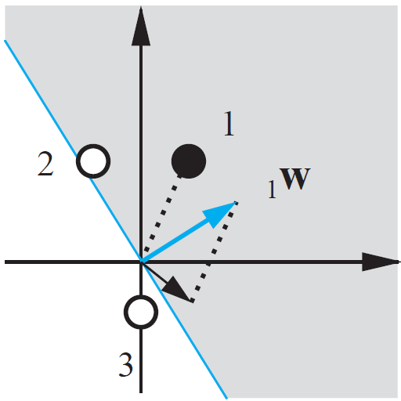


Perceptron Learning Rule
Therefore the network has not returned the correct value for ${\text{p}}_{1}$(a=0 while ${\text{t}}_{1}=1$).
This leads to a decision boundary which puts ${\text{p}}_{1}$ in the wrong side (see the figure).
So we should use the first perceptron learning rule to update the weight vector.
3
32

Slide 33


Perceptron Learning Rule
Example 1 (Cont.):
Presenting ${\text{p}}_{2}$ to the network:
4
33

Slide 34



Perceptron Learning Rule
Therefore the network has not returned the correct value for ${\text{p}}_{2}$.
This leads to a decision boundary which puts ${\text{p}}_{2}$ in the wrong side (see the figure).
Because we would now like to move the weight vector away from the input ${\text{p}}_{2}$, we use the second perceptron learning rule to update the weight vector.
5
34

Slide 35


Perceptron Learning Rule
Example 1 (Cont.):
Presenting ${\text{p}}_{3}$ to the network:
6
35

Slide 36



Perceptron Learning Rule
Therefore the network has not returned the correct value for ${\text{p}}_{3}$.
This leads to a decision boundary which puts ${\text{p}}_{3}$ in the wrong side (see the figure).
Because we would now like to move the weight vector away from the input ${\text{p}}_{3}$, again we use the second perceptron learning rule to update the weight vector.
7
36

Slide 37

Perceptron Learning Rule
Example 1 (Cont.):
With new$_{1}\text{w}$, if we present any of the input vectors to the neuron, it will output the correct class for that input vector.
Therefore we use the third perceptron learning rule and actually do not change the weight vector.
It shows that the perceptron has finally converged and learned to classify the three vectors properly.
8
37

Slide 38



Perceptron Learning Rule
Example 2: The apple/orange pattern recognition problem
orange: apple:
Weight and bias initialization (iteration 0): W = [0.5 -1 -0.5] , b = 0.5
Applying the first input vector, ${\text{p}}_{1}$ , to the network:
$$⇒{\text{e}\text{ = }\text{t}}_{1}−\text{a} \text{= }\text{0 }\text{− }\text{1 }\text{= −}\text{1}$$
1
38

Slide 39


Perceptron Learning Rule
Example 2 (Cont.): The weight and bias update (iteration 1):
${\text{W}}^{new}={\text{W}}^{old}+\text{e} {\text{p}}^{T}$ = [0.5 -1 -0.5] + (-1)[1 -1 -1] = [-0.5 0 0.5]
${\text{b}}^{new}={\text{b}}^{old}+\text{e}$ = 0.5 + (-1) = -0.5
Applying the second input vector, ${\text{p}}_{2}$ , to the network:
$$⇒{\text{e}\text{ = }\text{t}}_{2}−\text{a} \text{= }\text{1}−\text{0} \text{= }\text{1}$$
2
39

Slide 40


Perceptron Learning Rule
Example 2 (Cont.): The weight and bias update (iteration 2):
${\text{W}}^{new}={\text{W}}^{old}+\text{e} {\text{p}}^{T}$ = [-0.5 0 0.5] + (1)[1 1 -1] = [0.5 1 -0.5]
${\text{b}}^{new}={\text{b}}^{old}+\text{e}$ = -0.5 + 1 = 0.5
Again applying the first input vector, ${\text{p}}_{1}$ , to the network:
$$⇒{\text{e}\text{ = }\text{t}}_{1}−\text{a} \text{= }\text{0}−1 \text{=} −\text{1}$$
3
40

Slide 41

Perceptron Learning Rule
Example 2 (Cont.): The weight and bias update (iteration 3):
${\text{W}}^{new}={\text{W}}^{old}+\text{e} {\text{p}}^{T}$ = [0.5 1 -0.5]+ (-1)[-0.5 2 0.5] =
${\text{b}}^{new}={\text{b}}^{old}+\text{e}$ = 0.5 + (-1) = -0.5
If we apply any of the input vectors to the neuron, it will output the correct class for that input vector, therefore the algorithm has finally converged to a solution and both input vectors will now be correctly classified.
4
41

Slide 42




Perceptron Learning Rule
Training Multiple-Neuron Perceptrons: We can generalize the perceptron learning rule for the multiple-neuron perceptron. To update the i^{th} row of the weight matrix we use:
To update the i^{th} element of the bias vector we use:
Then the perceptron learning rule can be written in matrix notation:
42

Slide 43

Convergence Conditions
It can be proved that the perceptron learning rule always converge to weights and biases that accomplish the desired classification under three following conditions:
(At least) a solution to the problem exists.
The weights are only updated when the input vector is misclassified (when $\text{e} \text{=} \text{0}$then ${\text{W}}^{new}={\text{W}}^{old}$ )
An upper bound, , exists for the length of the input vectors (they should not be $∞$).
43

Slide 44


Limitations of Single-layer Perceptron
Single-layer perceptron and its learning rule can only generate linear boundaries (hyperplanes) by the equation:$_{1}{\text{w}}^{T}\text{p}+\text{b}=0$. Therefore they are only used to solve linearly separable problems.
There are many functions like XOR (or other patterns shown below) that are linearly inseparable and a single-layer perceptron is not be able to learn them properly. We use a multilayer perceptron to learn them.
44

Slide 45

Thanks for your attention
End of chapter 3
Hamidreza Baradaran Kashani
45

